Slide 1
IBM Attrition
Ashutosh Shukla

Slide 2



Business Problem Definition
Comparing different job features to Job Satisfaction to reduce attrition.

Slide 3

Dataset Overview
Job Satisfaction
Hourly Rate
Distance From Home
Education
Job Involvement
Dataset had 35 Features

Slide 4

Correlations with Job Satisfaction
Feature | Correlation
Hourly Rate | -0.071335
Distance from home | -0.003669
Education | -0.011296
Job Involvement | -0.021476

Slide 5

Conclusion
There is no significant correlation between Job Satisfaction and Hourly Rate, Distance From Home, Education, Job Involvement.

Slide 6
Mean Squared Error, R squared error and Training accuracy
Training accuracy: 0.3176043557168784
Mean Squared Error: 0.2635028710039144
R-squared: 0.7832041079220047

Slide 7
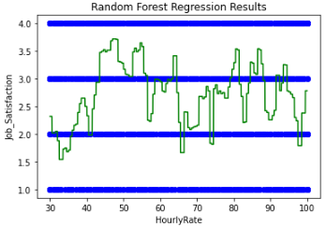
Job Satisfaction and Hourly Rate

